Slide 1




Tech Saksham Capstone
Project
PsyCh ore
  A online safe nook for everyone.

Slide 2
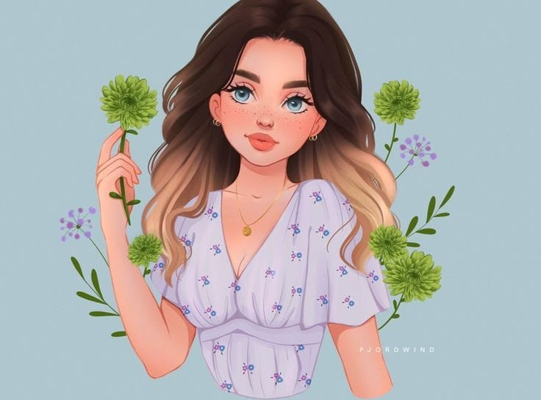

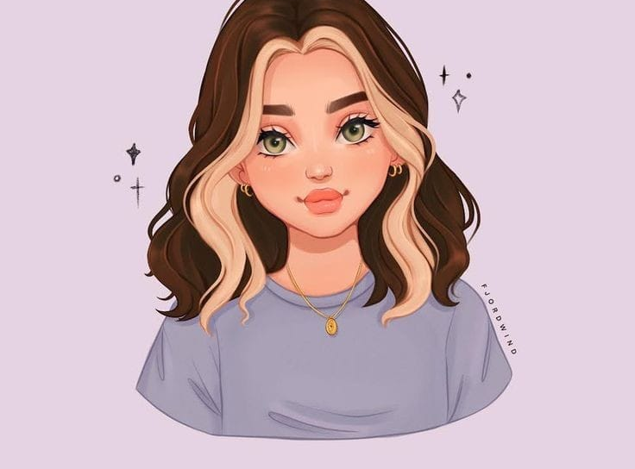
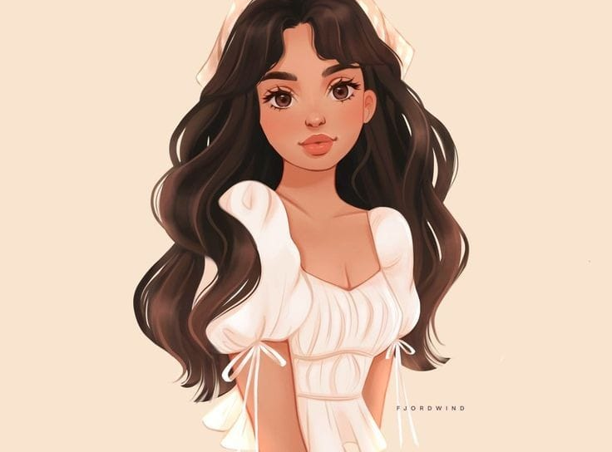
Presented by Team members
Team leader
Member 1
Member 2
Member 3
2
3
1
3
4
1
1
2
Himani Mehta
SPMC, BSc(H) Comp Sci
Anchal Mor
SPMC, BSc(H) Comp Sci
Jagriti Mittal
SPMC, BSc(H) Comp Sci
Harshmeet Kaur
SPMC, BSc(H) Comp Sci
Guided by Ms. Vidhi Pandya

Slide 3

Problem Statement
Our objective is to create a fun online safe space for people to make them feel understood, validated and cared for. An interactive, user-friendly space where we spread mental health awareness.

Slide 4
The Idea behind PsyCh ore?
  It is to provide a comprehensive online resource for individuals seeking information, support, and resources related to mental health.
  Poor awareness about symptoms of mental illness, myths & stigma related to it, lack of knowledge on the treatment availability & potential benefits of seeking treatment are important causes for the high treatment gap.
  By offering a safe and supportive online environment, individuals can feel more comfortable seeking help and taking steps towards improving their mental health and well-being.

Slide 5

Agenda
  To create mental health awareness.
  To make resources more accessible.
  To promote mindful activities.
  To promote self-awareness through fun quizzes and playlists.
  To make everyone feel safe and connected.

Slide 6

“Just because no one else can heal or do your inner work for you doesn't mean you can, should, or need to do it alone.”

Slide 7
Technology and tools
Technology
Tools
References
Html5, CSS3, JavaScript, nodejs, MySQL
Canva, Pinterest, Google, YouTube, Spotify, Amazon, Flipkart
Psych2go youtube channel, Wondermind, 16personalities, NMHP, WHO, talkspace, psychiatry

Slide 8
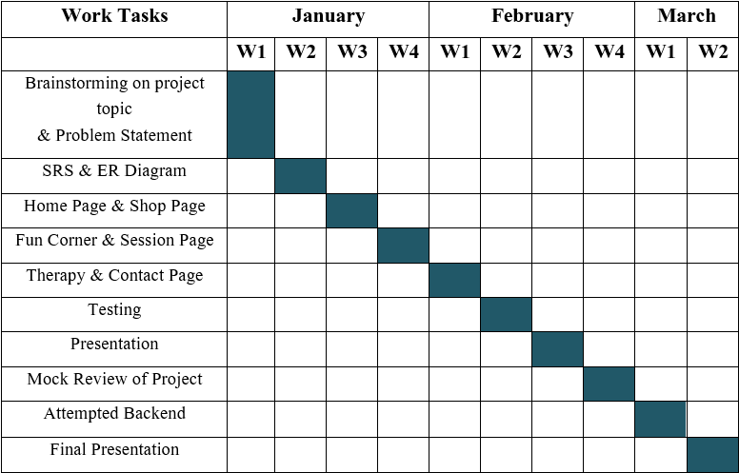
Timeline Chart

Slide 9
Features we pertained in PsyCh ore
1
2
3
Popular articles related to mental health
Guided Meditation Videos
Weekly journaling prompt ideas
4
5
6
Amazing monthly Newsletters
Interactive Sessions on current mental health concerns
Fun Corner of PsyCh ore

Slide 10
Features we pertained in PsyCh ore
2
3
7
8
9
Shop filled with top-rated books and journals
Various options to connect with qualified therapists
Connect with us option
5
6

Slide 11
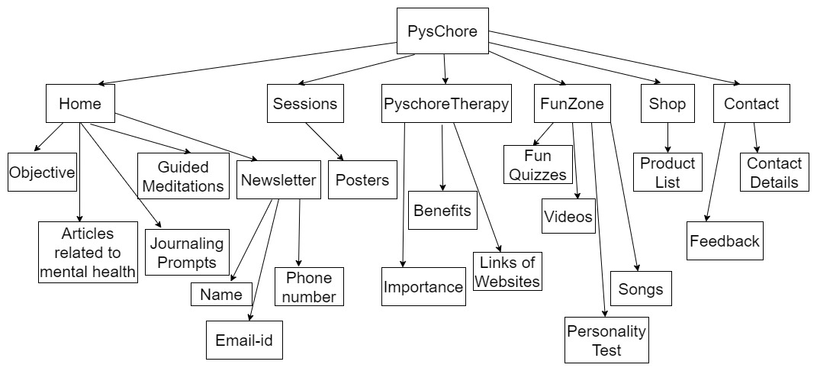
Flow Chart

Slide 12
Limitations
Limited Interaction
Accessibility
Not a substitute for professional care

Slide 13
Future Scope
Integration of Technology
Increased Personalization
Community Support Groups and Forums

Slide 14
It was pleasant to meet all of you!
Thank you for listening

